Slide 1
Unsupervised Paraphrase Generation
2022.4.1
Yi Chen

Slide 2
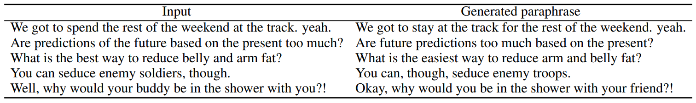
What is Paraphrase Generation
Paraphrase generation is the task of generating an output sentence which is semantically identical to a given input sentence but with variations in lexicon or syntax.

Slide 3
Content
Part 1: Revisiting Pivot-Based Paraphrase Generation: Language Is Not the Only Optional Pivot
Part 2: Unsupervised Paraphrasing with Pretrained Language Models
Part 3: ConRPG: Paraphrase Generation using Contexts as Regularizer

Slide 4
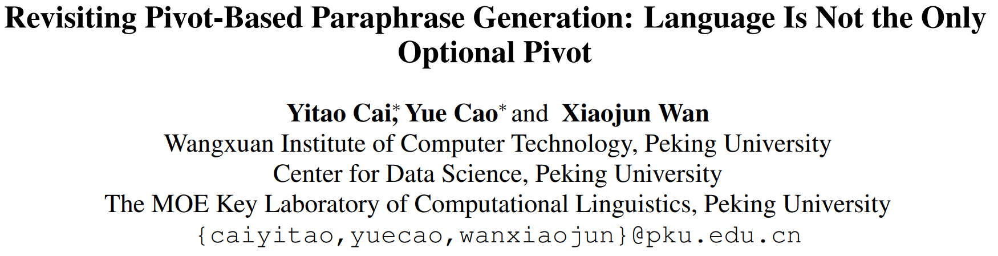

Slide 5
Background
Pivot-based methods, also known as the roundtrip translation, have shown promising results in generating high-quality paraphrases. However, existing pivot-based methods all rely on language as the pivot, where large-scale, high-quality parallel bilingual texts are required.
we explore the feasibility of using semantic and syntactic representations as the pivot for paraphrase generation.

Slide 6
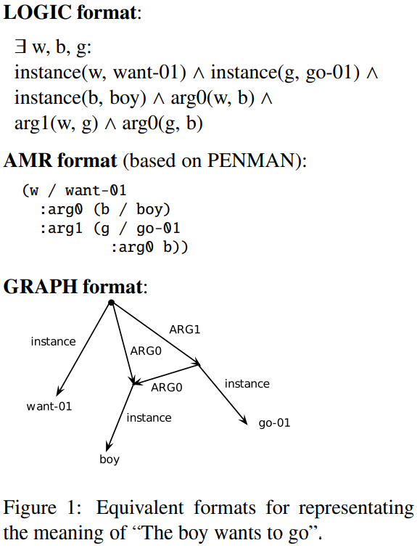
Introduction of Pivots
i) Language
There are hundreds of languages in the world, and a sentence has different expressions in different languages.
Therefore, we can take the sentence representation in another language as the pivot.
ii) Abstract Meaning Representation (AMR)
AMR is a rooted, labeled, acyclic graph which abstracts away from syntax and preserves semantics.
Nodes in AMR graph are concepts, which are highly related to English words.
Edges represent semantic relations between concepts.
Since AMR only keeps semantic information, paraphrases can share the same AMR graph.

Slide 7
Introduction of Pivots
iii) Universal Dependencies (UD)
UD is a framework for consistent annotation of parts of speech, morphological features and syntactic dependencies across human languages.
Nodes in UD are tokens in sentences.
Edge labels, Different from AMR, represent syntactic information.
iv) Latent Semantic Representation (LSR)
LSR (i.e. a dense vector) is also a simple way of meaning representation.
We use a deep neural model to obtain the latent semantic representation of a given sentence.

Slide 8
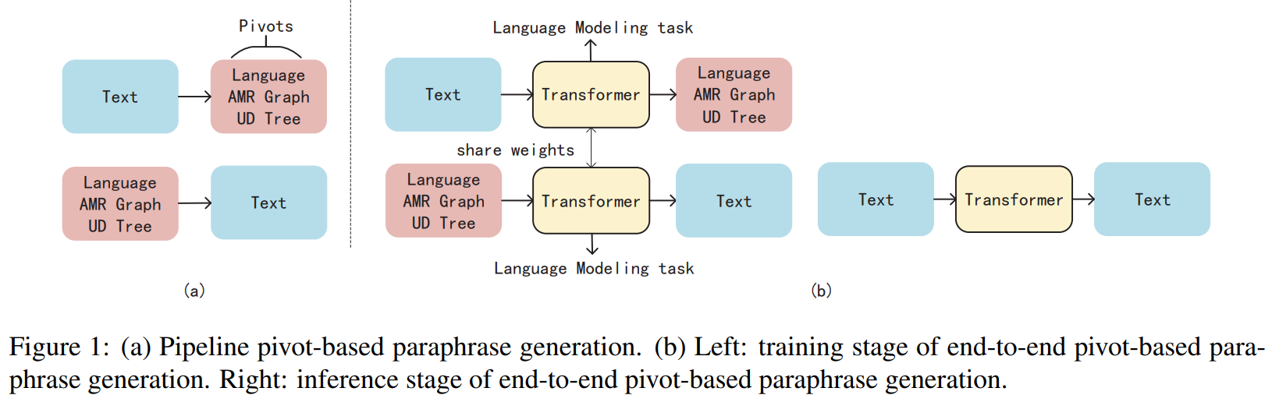
Pipeline/End-to-End Pivot-Based Paraphrase Generation

Slide 9
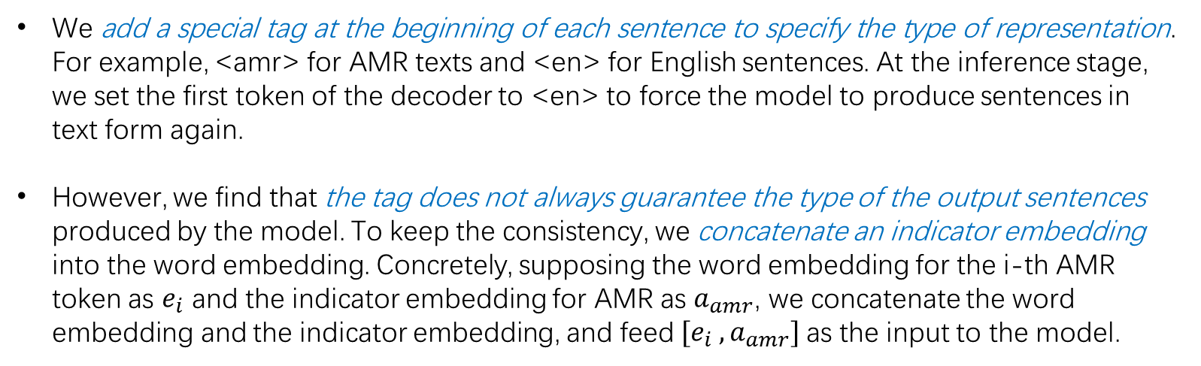
Tag and Indicator Embeddings (End-to-End cont.)
We add a special tag at the beginning of each sentence to specify the type of representation. For example, <amr> for AMR texts and <en> for English sentences. At the inference stage, we set the first token of the decoder to <en> to force the model to produce sentences in text form again.
However, we find that the tag does not always guarantee the type of the output sentences produced by the model. To keep the consistency, we concatenate an indicator embedding into the word embedding. Concretely, supposing the word embedding for the i-th AMR token as $e_{i}$ and the indicator embedding for AMR as $a_{amr}$, we concatenate the word embedding and the indicator embedding, and feed $[e_{i} , a_{amr}]$as the input to the model.

Slide 10
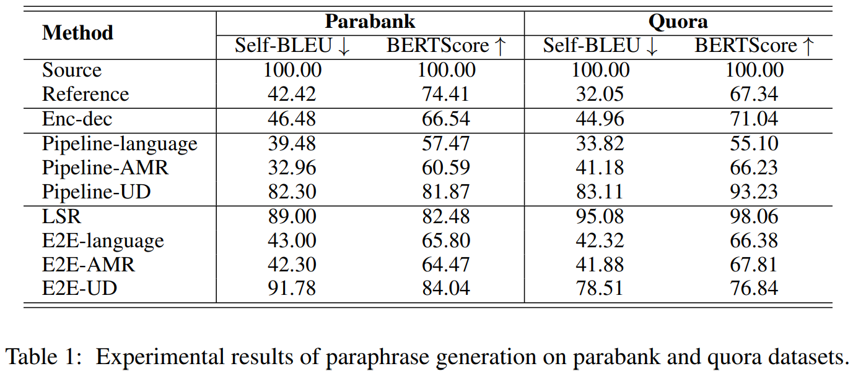
Experiments

Slide 11
Summary of Observations
The Pipeline-language method generates paraphrases of low fidelity scores and low fluency scores. Pipeline-language method is more likely to change the semantics of sentences and more sensitive to domains. The E2E-language method can alleviate the semantic changes to some extent, generating paraphrases with good quality.
The UD-based and LSR methods tend to generate paraphrases with fewer changes in expression compared to the original sentence. However, they require much less human-annotated parallel samples for training compared to other methods.
AMR-based methods perform well in fidelity, diversity, and fluency, which indicates that language is not the only optional pivot and using AMR as the pivot is also a good choice for pivot-based paraphrase generation systems.
Compared to the Enc-dec method, Pipeline-AMR, E2E-language and E2E-AMR methods can generate paraphrases with similar fidelity, diversity and fluency scores, which indicates that parallel paraphrasing data may not be necessary for generating high-quality paraphrases.

Slide 12
Conclusions and Discussions
Pivot is important for keeping the semantics for paraphrase generation. The key point in paraphrase generation is to seek a good semantic pivot.
Semantic shifting is a nonnegligible problem. Compared with choosing other languages as pivot, choosing syntactic or semantic as pivot is a more direct way, and is less likely to incur semantic shift.
Using the AMR as the pivot can also produce high-quality paraphrases. But it still requires human-annotated parallel samples for training.
There might be some gaps between these training and inference stages for the end-to-end pivot-based method, where the end-to-end framework shares weights for text-to-pivot and pivot-to-text subtasks during training but performs a text-to-text task during inference.

Slide 13
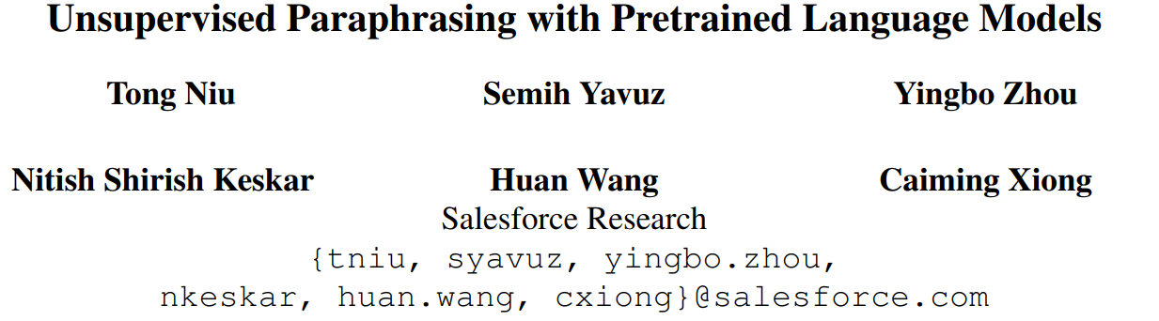

Slide 14
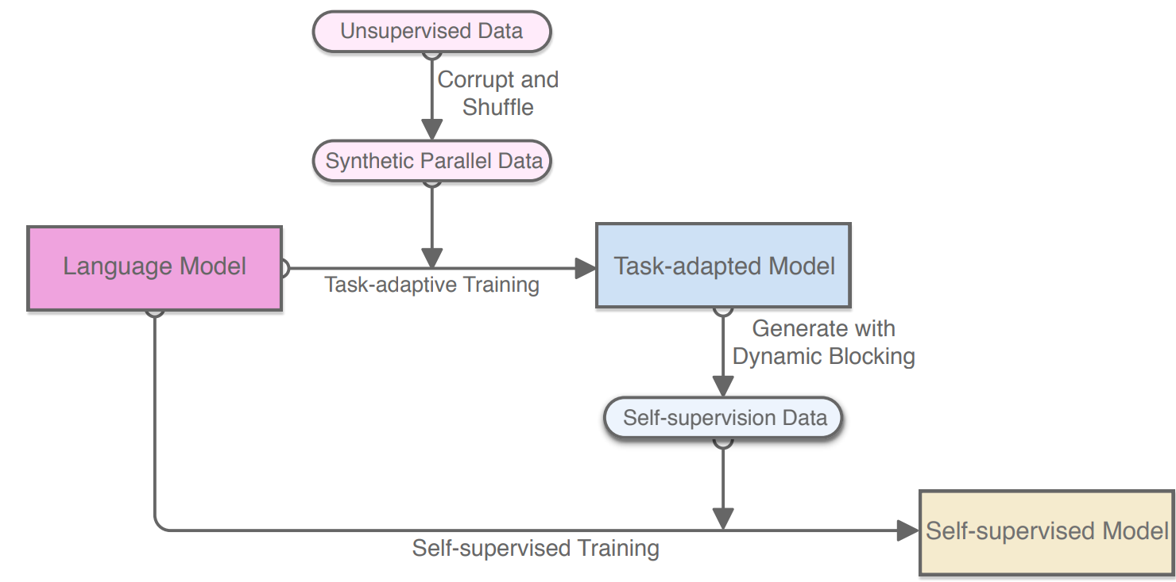
Corrupted Input Text as Pivot
Use the corrupted version of the input text sequence as pivot for paraphrase generation.
Reconstruct the original sequence from its corrupted (deletion and shuffling) version based on BART with a denoising auto-encoder objective.

Slide 15
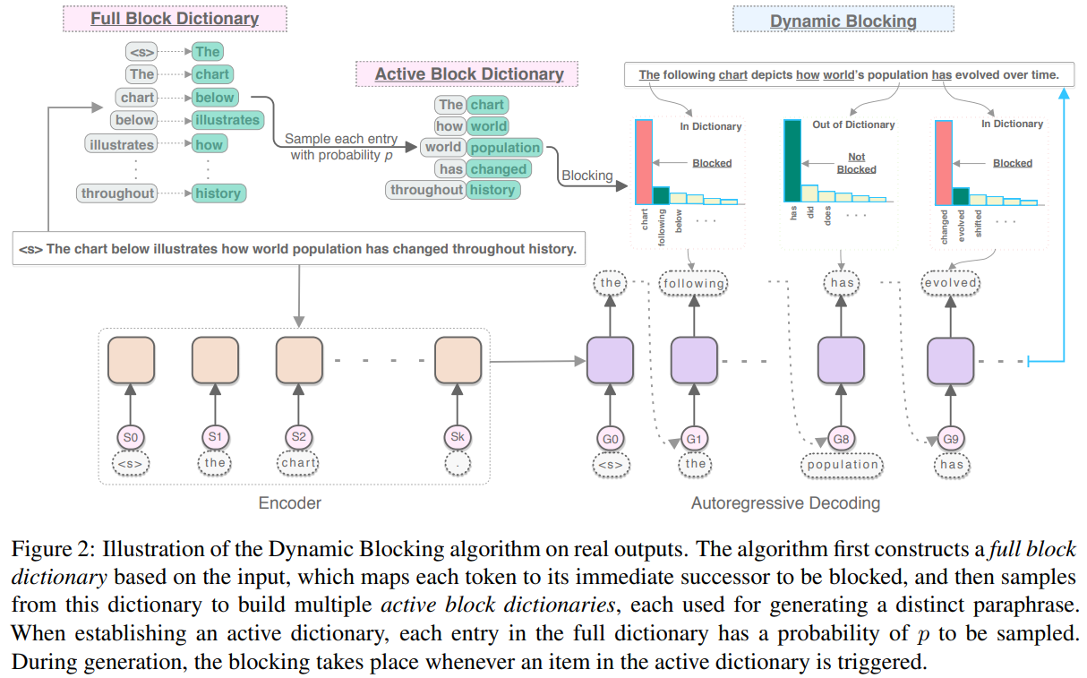
Dynamic Blocking for Generation Diversity

Slide 16
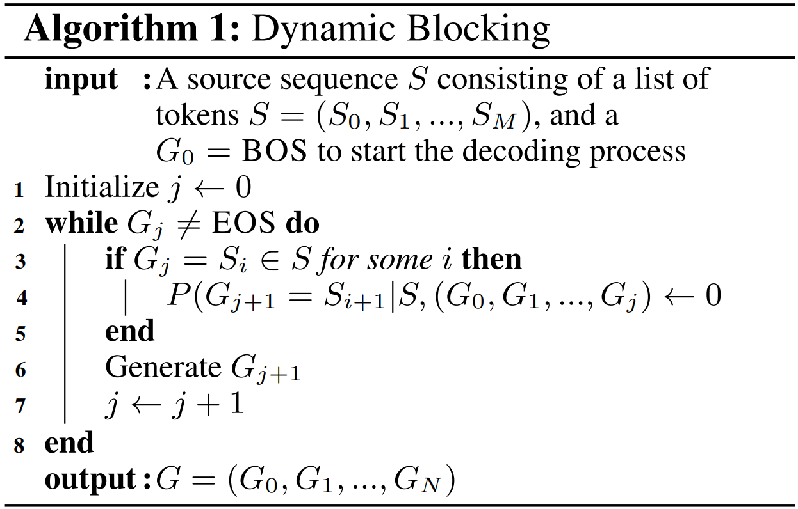
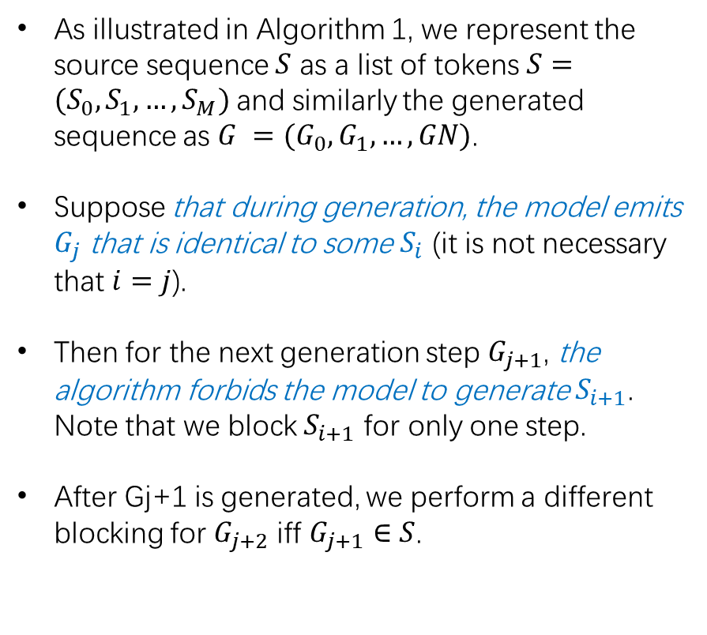
Dynamic Blocking for Generation Diversity
As illustrated in Algorithm 1, we represent the source sequence $S$ as a list of tokens $S=(S_{0}, S_{1}, …, S_{M})$and similarly the generated sequence as $G =(G_{0}, G_{1}, …, GN)$.
Suppose that during generation, the model emits $G_{j}$ that is identical to some $S_{i}$ (it is not necessary that $i=j$).
Then for the next generation step $G_{j+1}$, the algorithm forbids the model to generate $S_{i+1}$. Note that we block $S_{i+1}$ for only one step.
After Gj+1 is generated, we perform a different blocking for $G_{j+2}$ iff $G_{j+1}∈S$.

Slide 17
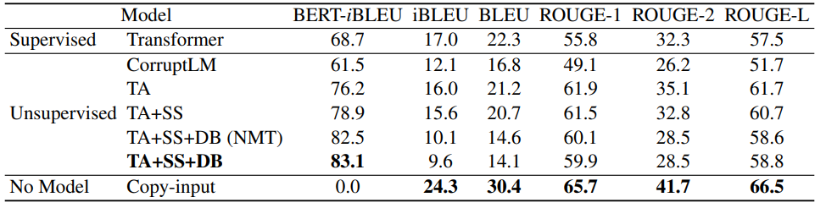
Problems of Existing Evaluation Metrics
We see that Copy-input achieves state-of-the-art results on all metrics except BERT-iBLEU, indicating that iBLEU, BLEU, and ROUGE scores are not reliable for evaluating paraphrasing quality.

Slide 18
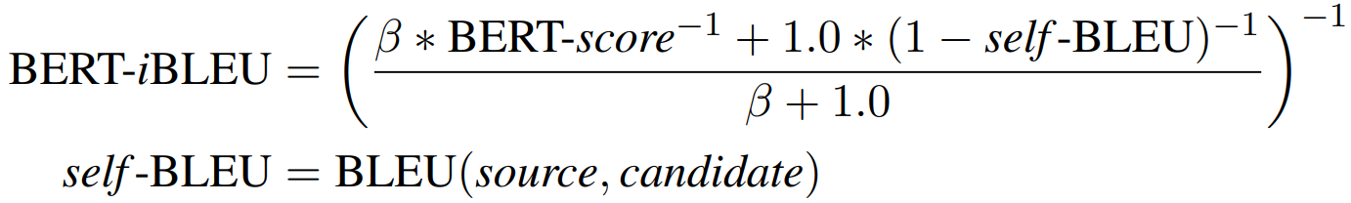
New Automatic Metric BERT-iBLEU
We propose a new metric named BERT-iBLEU which encourages semantic closeness while penalizing surface-form similarity.
For semantic closeness we use the unsupervised metric BERT-score, which leverages a pretrained language model to compute the cosine similarity between each token in the candidate and that in the reference using contextual embeddings.
For surface-form dissimilarity, we use one minus self-BLEU, where self-BLEU is the BLEU score between the source and the candidate.
Hence BERT-iBLEU (where i stands for inverse) is a weighted harmonic mean of the BERT-score and one minus self-BLEU.

Slide 19
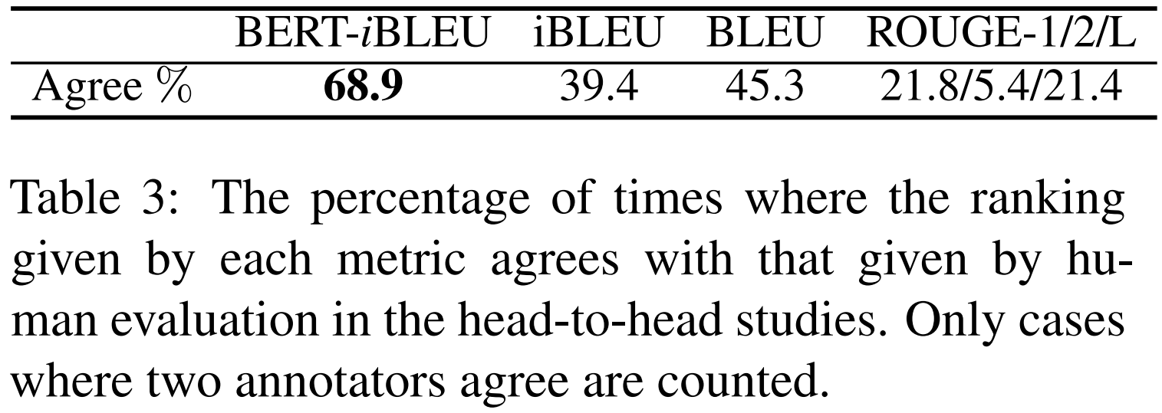
New Automatic Metric BERT-iBLEU
As an extreme case, though copying through the input leads to a perfect BERT-score, 1 − self-BLEU = 0; hence BERT-iBLEU = 0. This is the reason that we do not use the BERT-score directly to evaluate paraphrases.
Note that because BERT-iBLEU is reference-independent, it serves both as a metric to evaluate paraphrasing quality and as a criterion to re-rank generated candidates during task-adaptation and self-supervision.

Slide 20
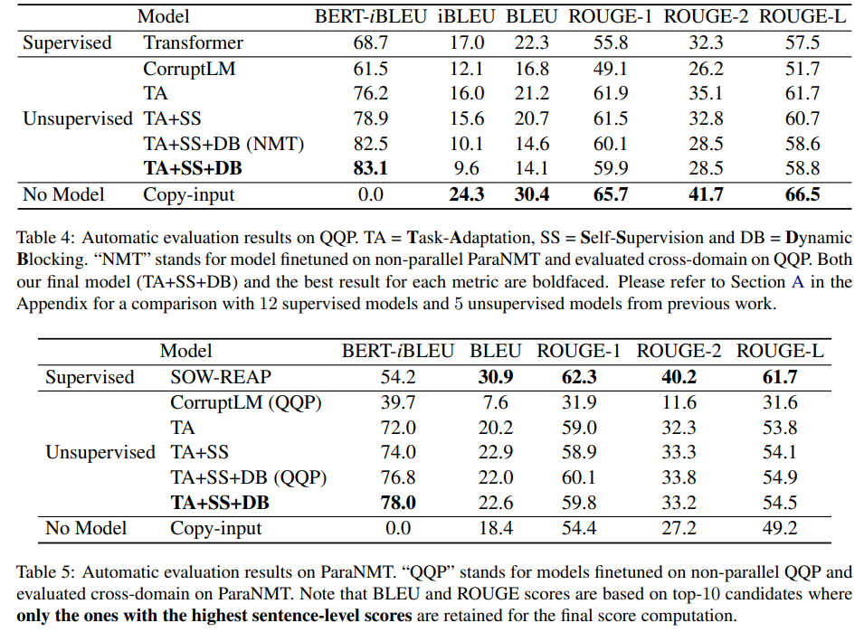
Experiments

Slide 21
Conclusions and Discussions
Corrupting the input sentence is another pivot for paraphrase generation.
It is hard to decide the corruption rate to keep the semantics while increasing the generation diversity. Some important keywords like names of persons or places might be deleted and hard for recovering.
Word-level shuffling may cause serious semantic shifting. It is difficult for even humans to reconstruct the original sentence from its word-level shuffled version. Consider shuffling in the clause, phrase or n-gram level?
Existing automatic metrics may be not reliable for evaluating paraphrase quality.
Using some reliable metrics to select high-quality pseudo-labeled paraphrases generated through the unsupervised method and then training a new seq-to-seq model based on the self-supervision data is beneficial for promoting the performance.
There is still way to go for designing decoding strategies to increase the generation diversity.

Slide 22
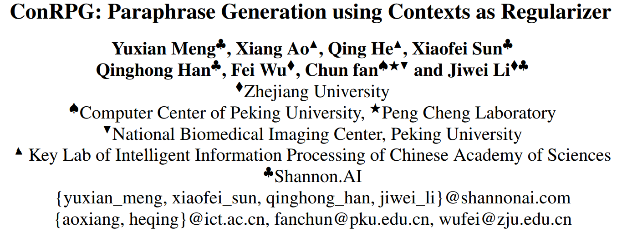

Slide 23
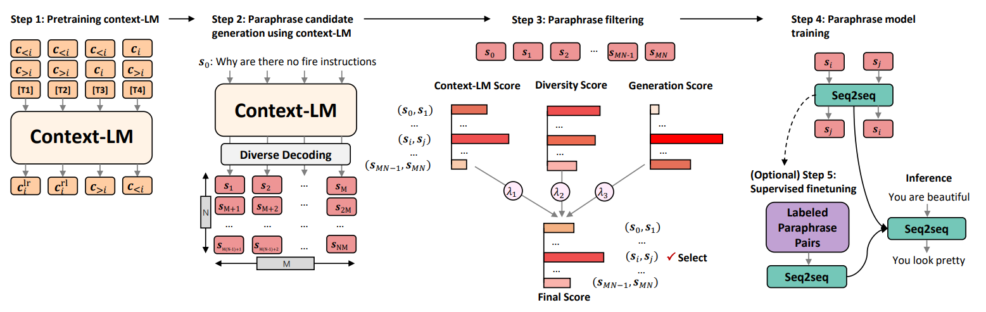
More Contexts as Pivot
The probabilities of generating two sentences with the same meaning given the same context should be the same.
We propose a pipelined system which consists of paraphrase candidate generation based on
1) contextual language models,
2) candidate filtering using scoring functions, and
3) paraphrase model training based on the selected candidates.

Slide 24
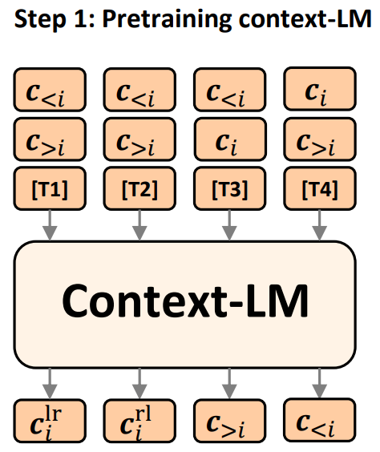
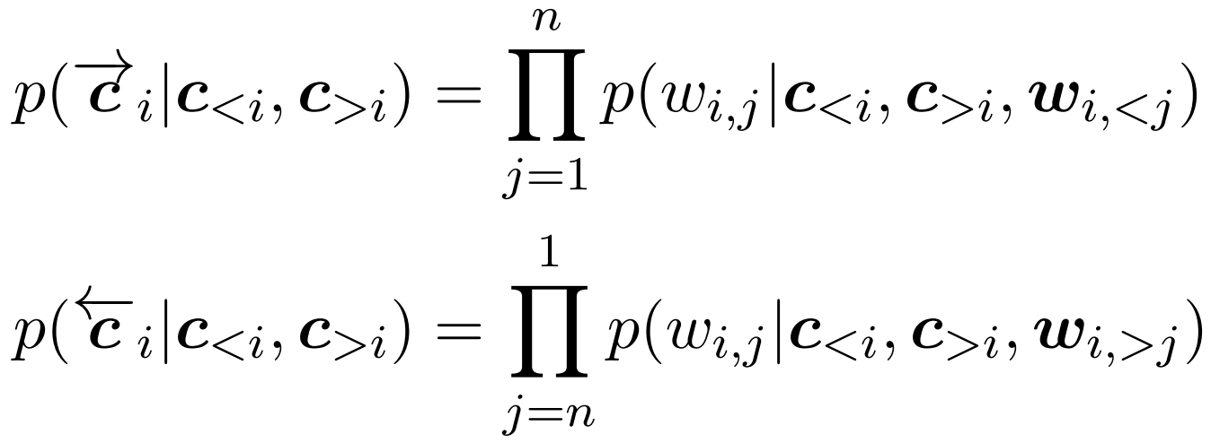
More Contexts as Pivot
Sentence-level text-infilling, similar to word2vec.
We consider the style of both left-to-right generation and right-to-left generation to optimize $p\left(c_{i} | c_{<i},c_{>i}\right):$

Slide 25
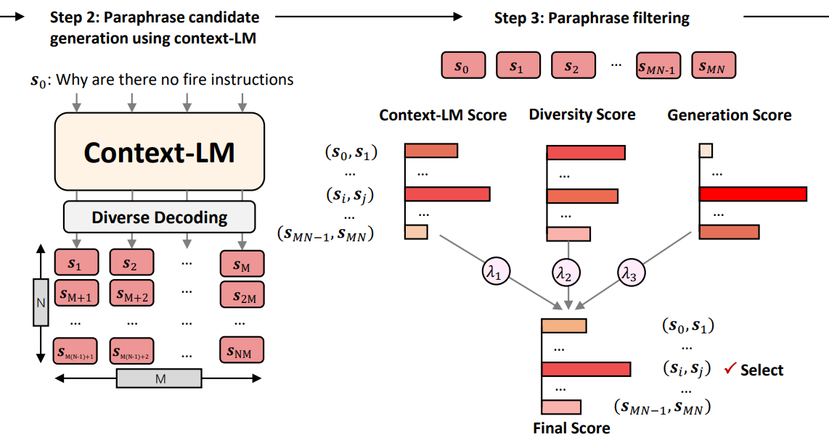
Paraphrase Filtering
The decoded candidates can not be readily used since
candidates often differ only by punctuation or minor morphological variations, with almost all words overlapping, and
many of them are not of the same meaning.
We thus propose to further rank a candidate pairs. The ranking model consists of three parts:

Slide 26
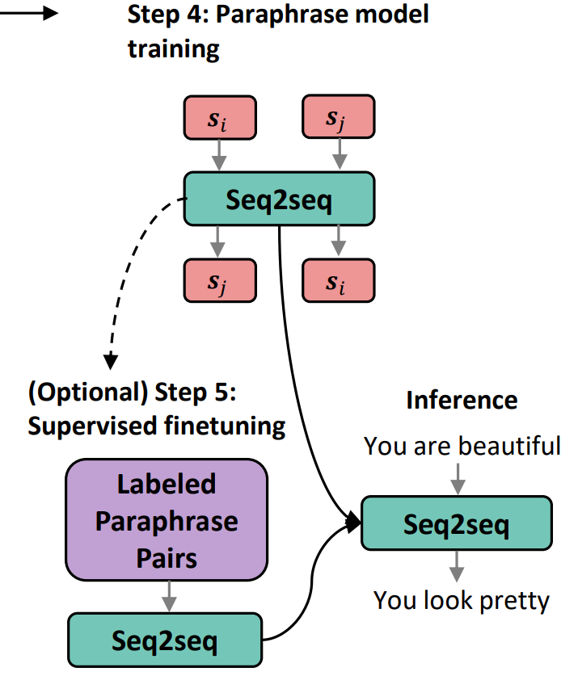
Paraphrase Model Training

Slide 27
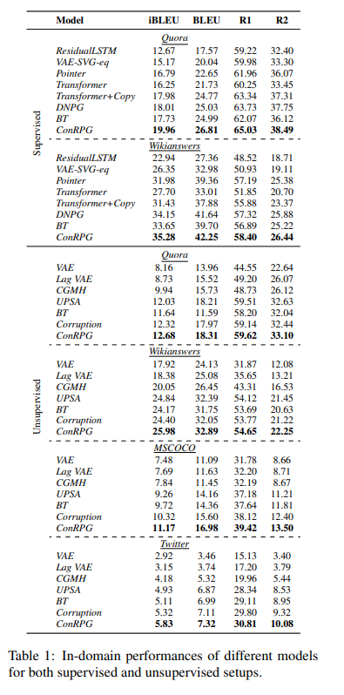
Experiments

Slide 28
Conclusions and Discussions
Contexts of a sentence is also a good pivot for paraphrase generation.
More complex metrics should be considered for filtering candidate pairs.
Removing the original sentence and predicting it only based on its contexts is still of high risk to loose its semantic meaning. We can still perform the text corruption or use the embedding of the original sentence to guide paraphrase generation.

Slide 29
QA

